Slide 1

B.Tech 6th Semester Mini project Presentation
“Microplastic degradation by Algae for Sustainable Development”
Presented by:
Gnana Deepika(2203051440110)
Kasireddy Vasavi(2203051440107)
Telugu Sai Prakash(2203051440124)
Ganthi Saikiran(2203051440115)
Teeguru Epsitha(2203051440061)
Supervisors: Anwesha
DEPARTMENT OF BIOTECHNOLOGY, PARUL INSTITUTE OF TECHNOLOGY, PARUL UNIVERSITY
NAME OF THE INSTITUTE, PARUL UNIVERSITY

Slide 2
Content of Presentation
Abstract
Introduction
Problem Statement
Literature Review
Project Module
Use case diagram/ER diagram/Flow diagram
Excepted Outcome of the Project
Limitation
Conclusion and Future Work
References
DEPARTMENT OF BIOTECHNOLOGY, PARUL INSTITUTE OF TECHNOLOGY, PARUL UNIVERSITY
NAME OF THE INSTITUTE, PARUL UNIVERSITY

Slide 3
Abstract
Microplastic pollution has emerged as critical environmental challenge due to its persistence in ecosystem and adverse effects on biodiversity. These tiny plastics particles, originating from industrial sources and the breakdown of large plastics, have been detected in waterbodies, soil, and even the atmosphere. Conventional removal methods such as filtration ,chemical treatments, and incineration have shown limited efficiency and often contribute to further environmental damage. As a sustainable alternative, microalgae based bioremediation offers a promising solution. Certain species, including Chlorella vulgaris and Dunaliella salina, can degrade microplastics through enzymatic activity while simultaneously supporting biofilm formation on plastic surfaces, accelerating biodegradation. Furthermore, algae-derived bioplastics present an eco-friendly alternative to petroleum-based plastics, addressing both plastic waste management and sustainability concerns. This review explores the potential of microalgae in tackling microplastic pollution, discussing its mechanisms, challenges, and future applications in large-scale wastewater treatment.
DEPARTMENT OF BIOTECHNOLOGY, PARUL INSTITUTE OF TECHNOLOGY, PARUL UNIVERSITY
NAME OF THE INSTITUTE, PARUL UNIVERSITY

Slide 4
Introduction
Plastic pollution has become an alarming global crisis, with microplastics defined as plastic particles smaller than 5 mm—posing a significant environmental threat. With global plastic production exceeding 359 million metric tons in 2018 and projected to triple by 2050, the accumulation of plastic waste has reached critical levels. Microplastics originate from both primary sources (such as cosmetic microbeads and industrial abrasives) and secondary sources (resulting from the breakdown of larger plastic items). These particles infiltrate aquatic ecosystems, soil, and even the air, leading to long-term ecological and health risks.
Despite various mitigation strategies, conventional plastic removal methods remain inefficient and unsustainable. Wastewater treatment plants have shown low microplastic removal rates (often below 50%), while incineration and chemical treatments contribute to secondary pollution in the form of toxic emissions. Additionally, recycling rates remain alarmingly low, with less than 10% of plastic waste effectively repurposed. These limitations highlight the urgent need for sustainable, biological solutions.
Microalgae-based bioremediation has gained attention as a natural, cost-effective approach to degrading microplastics. Certain algal species can attach to plastic surfaces, forming biofilms that facilitate enzymatic breakdown. Moreover, algae-derived bioplastics offer a renewable alternative to conventional plastics, reducing dependency on fossil fuels. This review explores the role of microalgae in microplastic degradation, analyzing the mechanisms, challenges, and future applications of algal bioremediation in wastewater treatment and environmental conservation.
DEPARTMENT OF BIOTECHNOLOGY, PARUL INSTITUTE OF TECHNOLOGY, PARUL UNIVERSITY
NAME OF THE INSTITUTE, PARUL UNIVERSITY

Slide 5
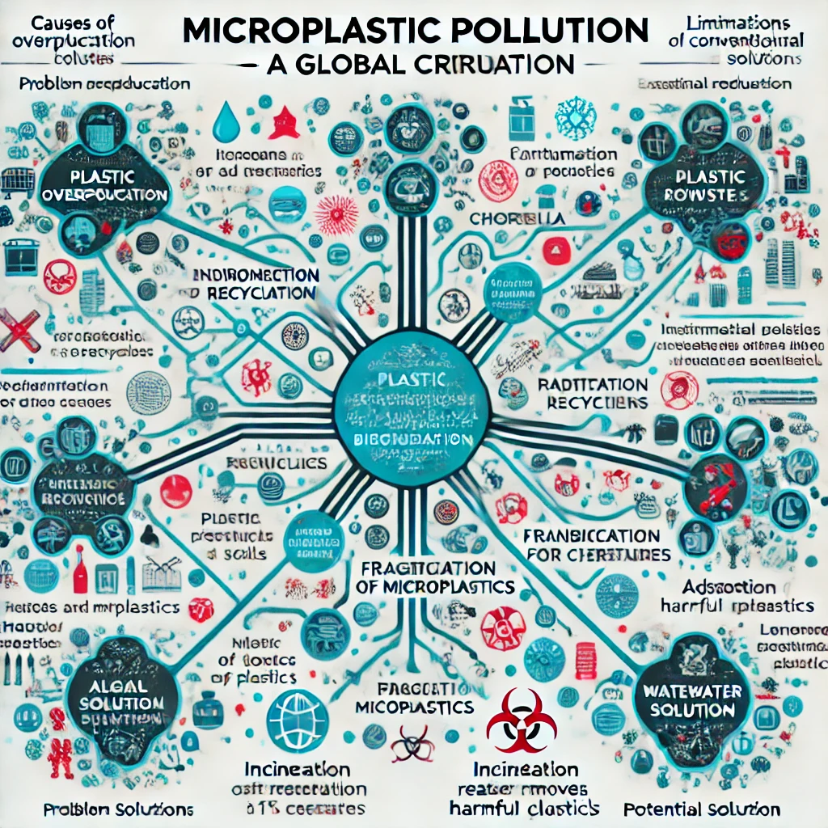
PROBLEM STATEMENT
Microplastic Pollution: A Growing Crisis & A Sustainable Solution
DEPARTMENT OF BIOTECHNOLOGY, PARUL INSTITUTE OF TECHNOLOGY, PARUL UNIVERSITY
NAME OF THE INSTITUTE, PARUL UNIVERSITY

Slide 6
LITERATURE REVIEW
Title of the paper | Algae speices used | Key points | References
Unveiling the Potential: Biodegradation of Plastics by Algae | Dunaliella salina, Chlamydomonas reinhardtii, Scenedesmus dimorphus | Biodegradation Process, Role of Algae in Plastic Degradation, | Agate, S., Shivalkar, S., Khan, A., & Soni, S. (2024).
Biodegradation of Low-Density Polyethylene (LDPE) Sheet by Microalga, Uronema africanum Borg | Uronema africanum Borge | Hydrocarbons (e.g., Nonane, Tricosane, Tetracosane), Fatty Acids (e.g., n-Hexadecanoic acid) | Scientific Reports (2021), DOI: 10.1038/s41598-021-96315-6【17
Nature’s Fight Against Plastic Pollution: Algae for Plastic Biodegradation and Bioplastics Production | Chlorella vulgaris, Scenedesmus dimorphus, Anabaena spiroides, Oscillatoria princeps, Phormidium lucidum | Bioplastics (PHA, PHB), Hydrocarbons, Carbohydrates | Environmental Science and Ecotechnology (2020), DOI: 10.1016/j.ese.2020.100065【19】

Slide 7
PROJECT MODULE
Algae Selection & Cultivation
  Identifying effective algae species (Chlorella vulgaris, Scenedesmus sp.) for microplastic degradation.
  Optimizing growth conditions (pH, temperature, nutrients) for enhanced biodegradation.
Microplastic Degradation Process
  Algae attach to plastic surfaces and form biofilms .
  Enzymatic activity breaks down microplastics into smaller, biodegradable fragments
Experimental Setup & Monitoring
  Conducting lab and field studies to measure degradation efficiency .
  Tracking changes in plastic structure, chlorophyll content, and algal growth
Real-World Applications
  Implementing algae-based bioremediation in wastewater treatment plants .
  Exploring potential for algae-derived bioplastics as an alternative to petroleum-based plastics .
DEPARTMENT OF BIOTECHNOLOGY, PARUL INSTITUTE OF TECHNOLOGY, PARUL UNIVERSITY
NAME OF THE INSTITUTE, PARUL UNIVERSITY

Slide 8
Expected Outcome
High Microplastic Removal Efficiency:
Expecting 70–98% degradation under optimized lab conditions.
Improved Water Quality: Reduction in toxic plastic residues, heavy metals, and pollutants .
Scalability Potential: Feasibility of large-scale wastewater treatment integration .
Eco-Friendly Alternatives: Algae-derived bioplastics as a sustainable replacement for conventional plastics.
DEPARTMENT OF BIOTECHNOLOGY, PARUL INSTITUTE OF TECHNOLOGY, PARUL UNIVERSITY
NAME OF THE INSTITUTE, PARUL UNIVERSITY

Slide 9
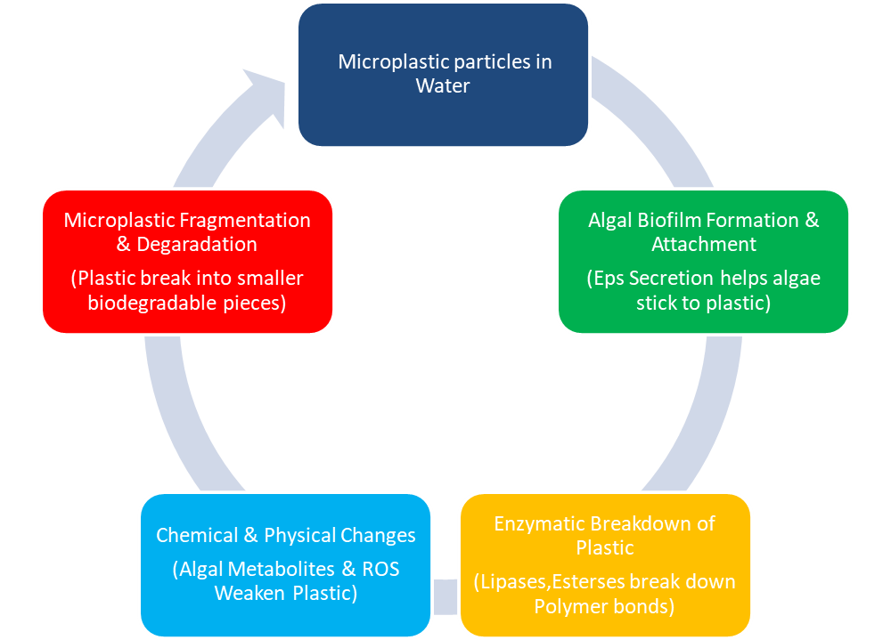
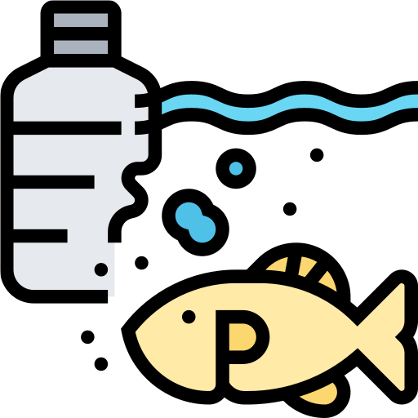


Mechanisms of Microplastic Degradation by Algae
FLOW CHART
DEPARTMENT OF BIOTECHNOLOGY, PARUL INSTITUTE OF TECHNOLOGY, PARUL UNIVERSITY
NAME OF THE INSTITUTE, PARUL UNIVERSITY

Slide 10
Case Studies & Experimental Evidence
Several Studies have explored how microalgae interact with microplastics , influceing degradation , photosynthesis , and aggregation.
Algae species | Microplastic type | Degradation Efficiency (%) | Key Obeservations
Chlorella vulgaris | Polysterene (PS) | 73.01% | Optimal at PH 7.5,reaction time 31.90 min
Chlorella Pyrenoidosa | Polyethelene (PE),PS | Negative impact on photosynthesis | 50% deop in Fv/Fm ratio,40% reduction in chlorophyll a
Scenedesmus abundans | Mixes MPs | Upto 98% removal | Effective in waste water treatment
Chlorella sp. + Scenedesmus sp. | Domestic wastewater MPs | 78-98% Nutrient removal | Combined species enhance plastic breakdown
DEPARTMENT OF BIOTECHNOLOGY, PARUL INSTITUTE OF TECHNOLOGY, PARUL UNIVERSITY
NAME OF THE INSTITUTE, PARUL UNIVERSITY

Slide 11
Advantages of Algae-Based Microplastic Removal
“ Comparision of Algae-Based and Traditional Microplastic Removal Methods ”
Aspect | Algae-Based Methods | Traditional Methods
Sustainability | Eco-friendly, natural process, minimal byproducts. | Uses chemicals,risk of toxic byproducts.
Cost-Effectiveness | Budget-friendly, low operational costs. | Expensive, require chemical production.
Scalability | Easily integarated into wastewater plants. | Limited scability, high infrastructure costs.
Efficiency | Up to 94.5% removal efficiency. | Varies, sometimes lower efficiency.
Environment Impact | Produces biodegradable waste, reusable as biofertilizer. | Generates toxic sludge, requires disposal.
DEPARTMENT OF BIOTECHNOLOGY, PARUL INSTITUTE OF TECHNOLOGY, PARUL UNIVERSITY
NAME OF THE INSTITUTE, PARUL UNIVERSITY

Slide 12
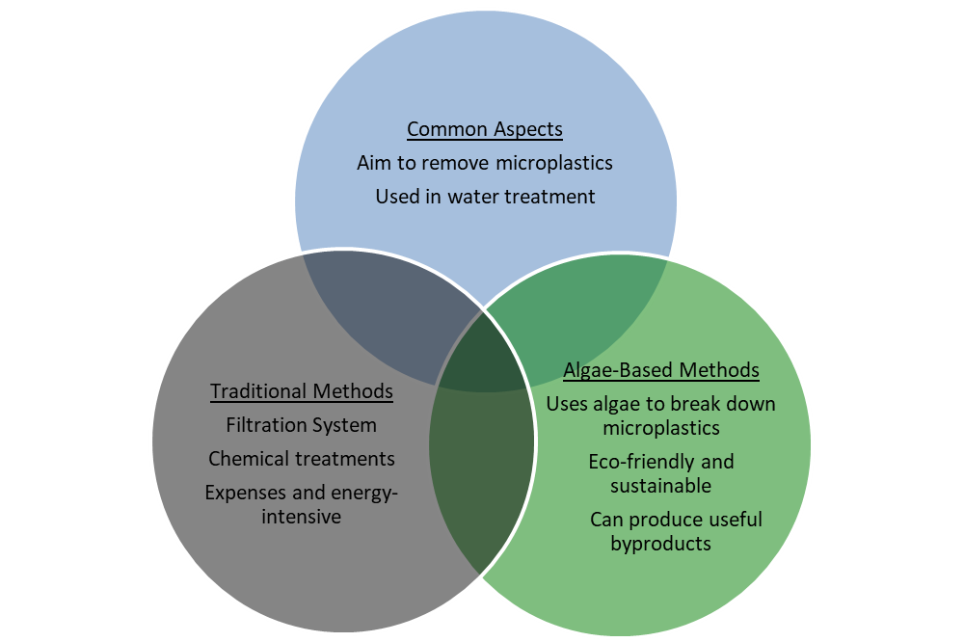


Comparision of Microplastic Removal methods
DEPARTMENT OF BIOTECHNOLOGY, PARUL INSTITUTE OF TECHNOLOGY, PARUL UNIVERSITY
NAME OF THE INSTITUTE, PARUL UNIVERSITY

Slide 13
Challenges & Limitations
Efficiency Issues: Slow Degradation Rate
Not all algae strains can break down plastics effectively.
The process depends on enzymes, which some algae don’t produce.
Certain pollutants, like pharmaceuticals, are tough for algae to remove.
Environmental Factors Affecting Algae Performance
Temperature, pH, and nutrients all play a role in efficiency.
Warm temperatures boost algae growth, but extreme heat can be harmful.
High nitrogen and phosphorus levels speed up growth but can also trigger harmful algal blooms.
Risks of Algal Blooms
Some algae produce toxins that harm fish, marine life, and even humans.
Massive blooms deplete oxygen in the water, creating dead zones.
Climate and pollution make blooms more common, making prevention crucial.
DEPARTMENT OF BIOTECHNOLOGY, PARUL INSTITUTE OF TECHNOLOGY, PARUL UNIVERSITY
NAME OF THE INSTITUTE, PARUL UNIVERSITY

Slide 14
CONCLUSION AND FUTURE WORK
Conclusion:
  Microalgae-based bioremediation is a promising, sustainable approach for microplastic degradation
  Certain algae species demonstrate high plastic removal efficiency and contribute to improved water quality .
  The process is cost-effective and scalable for wastewater treatment applications.
Future Work:
  Enhancing Algal Efficiency: Genetic modifications or co-cultivation strategies to improve degradation .
  Field Studies: Large-scale testing in real-world polluted water bodies .
  Bioproduct Development: Exploring algae-derived bioplastics for commercial applications.
DEPARTMENT OF BIOTECHNOLOGY, PARUL INSTITUTE OF TECHNOLOGY, PARUL UNIVERSITY
NAME OF THE INSTITUTE, PARUL UNIVERSITY

Slide 15
References
Cai, Z., Li, M., Zhu, Z., Wang, X., Huang, Y., Li, T., Gong, H., & Yan, M. (2023). Biological degradation of plastics and microplastics: A recent perspective on associated mechanisms and influencing factors. Microorganisms, 11(7), 1661.
Chia, W. Y., Tang, D. Y. Y., Khoo, K. S., Lup, A. N. K., & Chew, K. W. (2020). Nature’s fight against plastic pollution: Algae for plastic biodegradation and bioplastics production. Environmental Science and Ecotechnology, 4, 100065.
Dogruoglu, İ., Akarsu, Y., Şen, Ç. S., Pekcan, Ö., & Uysal, B. Ö. (2023). Sol-Gel and Gel-Sol transitions of biodegradable Chlorella-κ-Carrageenan composites; Photon transmission study. Journal of Biodegradable Materials, 8(4), 345-359.
Akter, B., Shammi, M., & Kabir, Z. (2023). Algae for plastic biodegradation: An emerging approach in mitigating marine pollution. In Microbiology for Cleaner Production and Environmental Sustainability (Chapter 18, pp. 1-22).
Gao, N., Ning, R., & Deng, X. (2023). Feasibility, challenges, and future prospects of microalgae-based bioremediation techniques for removing microplastics from wastewater. Frontiers in Bioengineering and Biotechnology, 11, 1288439.
Nava, V., Matias, M. G., Castillo-Escriva, A., Messyasz, B., & Leoni, B. (2022). Microalgae colonization of different microplastic polymers in experimental mesocosms across an environmental gradient. Global Change Biology, 28, 1402–1413.
Hadiyanto, H., Khoironi, A., Dianratri, I., Huda, K., Suherman, S., & Muhammad, F. (2022). Biodegradation of oxidized high-density polyethylene and oxo-degradable plastic using Dunaliella salina. Environmental Pollutants and Bioavailability, 34(1), 469-481.
Lotfigolsefidi, F., Davoudi, M., Sarkhosh, M., & Bonyadi, Z. (2024). Removal of microplastics by algal biomass from aqueous solutions: Performance, optimization, and modeling. Scientific Reports, 15, 501.
DEPARTMENT OF BIOTECHNOLOGY, PARUL INSTITUTE OF TECHNOLOGY, PARUL UNIVERSITY
NAME OF THE INSTITUTE, PARUL UNIVERSITY

Slide 16
References
9. Hadiyanto, H., Khoironi, A., Dianratri, I., Huda, K., Suherman, S., & Muhammad, F. (2022). Biodegradation of oxidized high density polyethylene and oxo-degradable plastic using Dunaliella salina. Environmental Pollutants and Bioavailability, 34(1), 469-481
10. Chia, W. Y., Tang, D. Y. Y., Khoo, K. S., Lup, A. N. K., & Chew, K. W. (2020). Nature’s fight against plastic pollution: Algae for plastic biodegradation and bioplastics production. Environmental Science and Ecotechnology, 4, 100065.
11.Gao, N., Ning, R., & Deng, X. (2023). Feasibility, challenges, and future prospects of microalgae-based bioremediation techniques for removing microplastics from wastewater. Frontiers in Bioengineering and Biotechnology, 11, 1288439.
12. Alazaiza, M. Y. D., He, S., Su, D., Abu Amr, S. S., Toh, P. Y., & Bashir, M. J. K. (2023). Sewage water treatment using Chlorella vulgaris microalgae for simultaneous nutrient separation and biomass production. Separations, 10(4), 229.
13. Gao, W., Xu, M., Zhao, W., Yang, X., Xin, F., Dong, W., Jia, H., & Wu, X. (2024). Microbial degradation of (micro)plastics: Mechanisms, enhancements, and future directions. Fermentation, 10(9), 441.
14. Bakaraki Turan, N., Sari Erkan, H., and Onkal Engin, G. (2021). Microplastics inwastewater treatment plants: occurrence, fate and identification. Process Saf. Environ.Prot. 146, 77–84.
15. Lotfigolsefidi, F., Davoudi, M., Sarkhosh, M., & Bonyadi, Z. (2025). Removal of microplastics by algal biomass from aqueous solutions: Performance, optimization, and modeling. Scientific Reports, 15, 501.
16. Davoudi, M., Lotfigolsefidi, F., Sarkhosh, M., & Bonyadi, Z. (2025). Cost-effective microplastic removal using Chlorella vulgaris: A comparative study. Journal of Environmental Biotechnology, 12(3), 177-189.
DEPARTMENT OF BIOTECHNOLOGY, PARUL INSTITUTE OF TECHNOLOGY, PARUL UNIVERSITY
NAME OF THE INSTITUTE, PARUL UNIVERSITY

